Slide 1


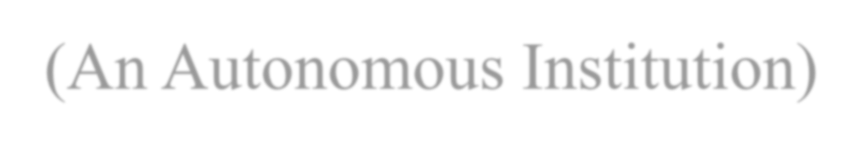
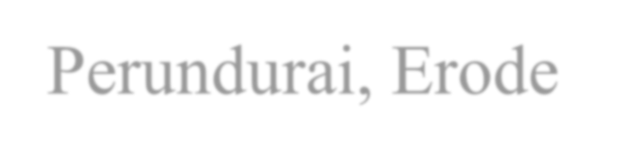

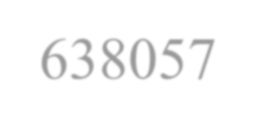
RISK GUARD
Erode Sengunthar Engineering College (An Autonomous Institution) Perundurai, Erode - 638057
A MULTI-MODAL AI DEEPFAKE DETECTION SYSTEM
UNDER THE GUIDANCE OF
PRESENTED BY :
Mr.Narendran R, | Abi Prasath R | (730422205002)
Assistant Professor, | Harija A | (730422205023)
Department of Information Technology | Hemabala S P | (730422205030)

Slide 2
Introduction
AI-generated media poses escalating threats to digital trust.
Deepfake images, cloned voices, and AI text are increasingly realistic.
Existing tools require manual upload and support only single modality.
Citizens lack real-time protection during everyday app usage.
RiskGuard addresses this with a multi-modal detection platform.
Combines local signal processing with cloud-based AI models.

Slide 3
Abstract
Multi-modal AI deepfake detection across image, voice, text, and video.
Hybrid CPU + GPU architecture with 6-signal ensemble detection.
Blockchain evidence preservation using SHA-256, IPFS, and Merkle trees.
Flutter mobile app with real-time protection overlay.
FastAPI web dashboard for law enforcement investigators.
Achieves 70-92% image, 65-85% voice, 70-88% text accuracy.

Slide 4
Need for System
Rapid increase in cyber fraud using AI-generated content
Fake voice scam attacks causing financial losses
Deepfake videos spreading misinformation online
AI-generated phishing texts targeting users
Existing tools lack real-time detection capability
No unified platform for multi-modal fraud detection
Need for secure legal evidence preservation
Protect citizens from digital impersonation threats

Slide 5
Problem Statement
AI voice cloning scams and impersonation attacks.
Deepfake videos spreading misinformation.
AI-generated phishing messages and social engineering.
Lack of unified tools for detecting multiple media types.
Privacy risks due to cloud-only detection systems.
No proactive protection during browsing social media apps.

Slide 6
Objectives
Build multi-signal ensemble detection for four modalities.
Achieve 60-92% accuracy on commodity hardware.
Implement blockchain evidence ledger with Merkle batching.
Reduce blockchain costs by up to 99.7%.
Develop real-time overlay monitoring whitelisted apps.
Create dual interface for citizens and investigators.

Slide 7
Existing System
Tools like Microsoft Video Authenticator, Deepware Scanner.
Require manual upload of suspicious content.
Limited to single-modality analysis.
Cloud-based GPU inference with processing delays.
Blockchain systems operate independently of detection.
No real-time automated protection.

Slide 8
Limitations of Existing System
Manual user-initiated analysis only.
Cannot cross-correlate signals across media types.
Slow processing: 10-60 seconds per item.
Requires constant cloud connectivity.
Detection and evidence preservation are fragmented.
No offline detection capability.
No proactive monitoring of messaging apps.

Slide 9
Proposed System
Comprehensive multi-modal AI detection platform.
Proactive real-time overlay monitors apps automatically.
Hybrid CPU + GPU local and cloud detection.
6-signal image, 6-signal voice, 4-signal text ensemble.
Integrated blockchain evidence with Merkle batching.
Operates on commodity 8 GB RAM hardware.
Dual interface: Flutter app + web dashboard.

Slide 10
Advantages of Proposed System
Multi-modal detection in a single unified platform.
Real-time proactive protection through system overlay.
Hybrid architecture enables offline detection.
Merkle batching reduces gas costs by 99.7%.
Live call monitoring with voice deepfake detection.
URL verification with threat intelligence feeds.
Processing under 200ms for voice, under 150ms for images.

Slide 11
System Architecture - Overview
Three-tier: Flutter frontend, FastAPI backend, external services.
Mobile app communicates via HTTPS REST APIs.
Backend processes AI detection across four modalities.
External: HuggingFace, Colab, Pinata IPFS, Polygon blockchain.
Overlay runs independently via Android Accessibility Services.

Slide 12
Image Analysis Module
6-signal type-adaptive weighted ensemble.
Classifies images into photograph, digital art, or screenshot.
NPR extracts camera sensor noise patterns.
DCT spectral analysis detects GAN/diffusion fingerprints.
Haar wavelet decomposition for texture features.
Cloud CNN + HuggingFace classifiers.
Failed signals excluded, weights redistributed.

Slide 13
Voice Analysis Module
6-signal hybrid CPU + GPU architecture.
Real-time streaming: 0.5s chunks under 200ms.
LFCC (30%) - Cepstral coefficient analysis.
CQT Phase (20%) - Phase coherence detection.
Modulation (20%) - Temporal envelope analysis.
Pitch/F0 (20%) - Autocorrelation contour tracking.
wav2vec2 (40%) - Fine-tuned on ASVspoof2019.

Slide 14
Text Analysis Module
4-signal ensemble with cloud and local methods.
DeBERTa (45%) - Fine-tuned on ChatGPT outputs.
RoBERTa (15%) - Short-text dampening fix.
Binoculars (20%) - Zero-shot LLM perplexity proxy.
Local Statistics (20%) - Lexical diversity analysis.
Independent phishing analysis with URL detection.
Risk score 0-100 with explanation.

Slide 15
Video Analysis Module
2-signal temporal-aware pipeline.
Per-frame image signal (60%) - Full 6-signal pipeline.
Temporal coherence (40%) - Farneback optical flow.
Samples at 3 FPS, maximum 30 frames.
Deepfakes show abrupt flow variance.
Real video shows smooth optical flow.

Slide 16
Blockchain Evidence Module
Follows Immutable Chain of Custody principle.
SHA-256 hash fingerprints the evidence file.
IPFS upload via Pinata for decentralized storage.
SQLite records off-chain metadata.
Merkle tree groups hashes, only root stored on-chain.
Single Polygon transaction anchors entire batch.
Cost reduction: 99.7% for 100 records.

Slide 17
Real-Time Protection Overlay
2300+ line Android system overlay.
Accessibility Services monitors whitelisted apps.
Supports WhatsApp, Chrome, Instagram, Telegram, Facebook.
Three modes: bubble, verdict card, call monitoring chip.
URL verification against URLhaus and blacklists.
Media capture for deepfake analysis.
Live call monitoring during active phone calls.

Slide 18
Technologies Used
Flutter – Mobile application development
FastAPI – Backend API development
Python – Core AI processing logic
OpenCV – Image and video analysis
HuggingFace API – Cloud AI model inference
Google Colab – GPU-based model execution
Solidity – Smart contract development
IPFS (Pinata) – Decentralized evidence storage
Polygon Blockchain – Secure evidence anchoring

Slide 19
Working of the System
Image: Classify type, assign weights, run 6 signals concurrently.
Voice: Preprocess audio, run 6 signals, fuse with cloud model.
Text: Run 4-signal ensemble with phishing analysis layer.
Overlay: Detect app, activate bubble, scan content automatically.
Evidence: Hash file, upload IPFS, Merkle batch, anchor on-chain.
Dashboard: SSE live feed, toast alerts, batch anchoring.

Slide 20
Detection Workflow
User uploads or captures suspicious content
System identifies the media type automatically
Image detection analyzes fake visual patterns
Voice detection checks cloned audio signals
Text detection identifies AI-generated messages
Video detection scans frames for deepfake manipulation
Final verification combines analysis results
Generates output with risk score and verdict

Slide 21
Testing and Evaluation
Unit Testing - Individual modules validated.
Integration Testing - Frontend-backend communication verified.
System Testing - Full application with real-world inputs.
User Acceptance Testing - End-user usability evaluation.
Performance: response time, speed, reliability assessed.
Feedback-driven UI enhancements.

Slide 22
Test Case Results
Test ID | Input Type | Expected Output | Result
TC01 | Real Image | Classified as Real | Passed
TC02 | Deepfake Image | Classified as Fake | Passed
TC03 | Real Video | Real with Confidence | Passed
TC04 | Deepfake Video | Fake with Confidence | Passed
TC05 | Invalid File | Error Message | Passed

Slide 23
Performance Analysis
Image detection: 70-92% accuracy on photographs.
Type-adaptive weighting prevents false positives on art.
Voice detection: 65-85% accuracy on audio clips.
Real-time streaming under 200ms per chunk.
Text detection: 70-88% on long-form content.
Local image analysis under 150ms.
Merkle batching reduces costs by 99.7%.

Slide 24
Applications
Cybercrime departments for fraud investigation
Social media protection from fake content
Banking fraud prevention from scam calls
Law enforcement for case investigation
Digital forensic teams for evidence analysis
Public safety from online threats

Slide 25
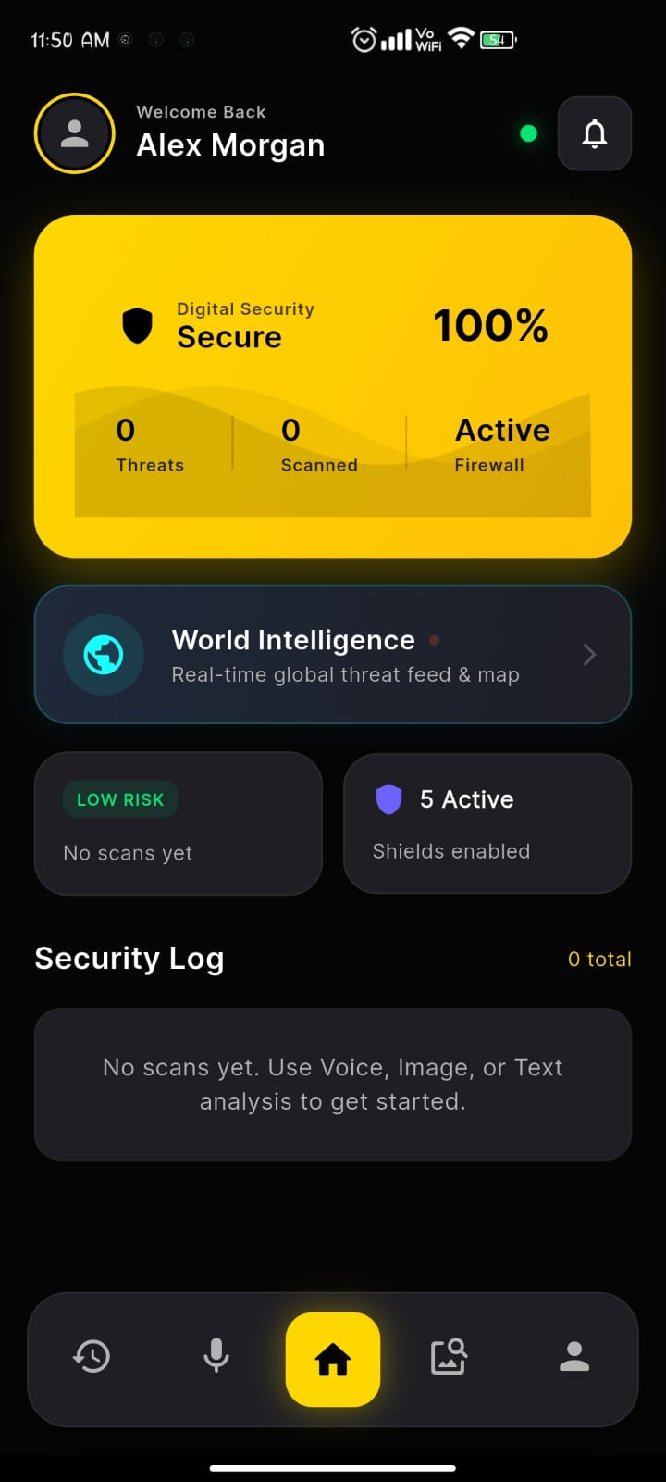
Home Page

Slide 26
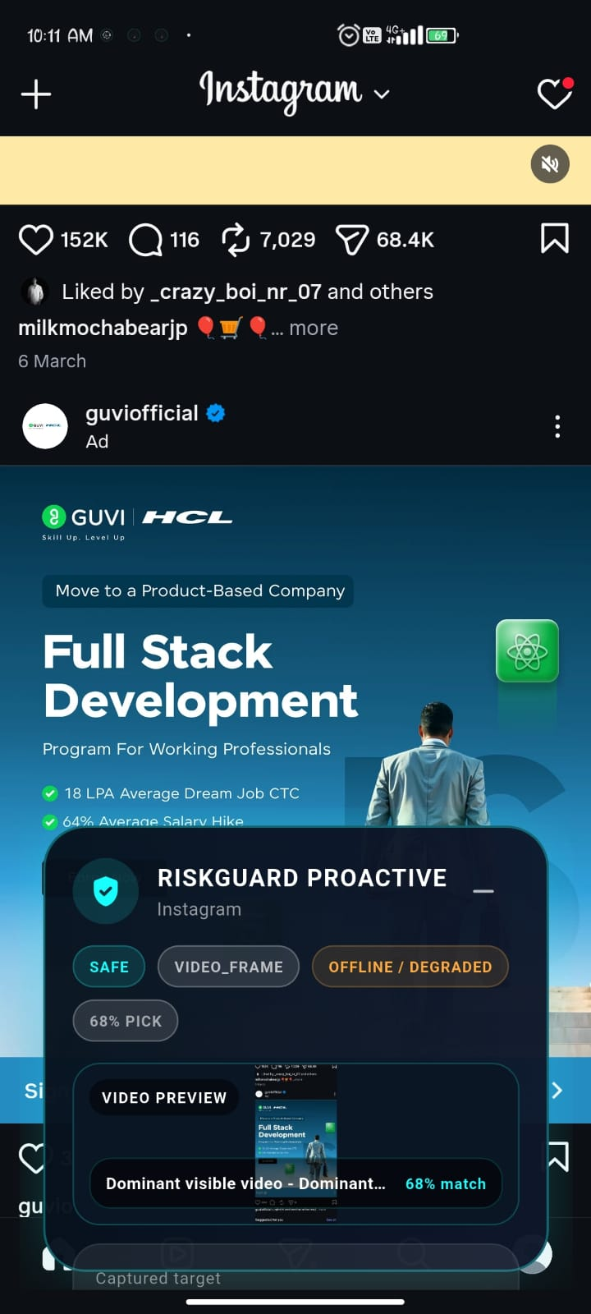
Real-Time Protection Overlay

Slide 27
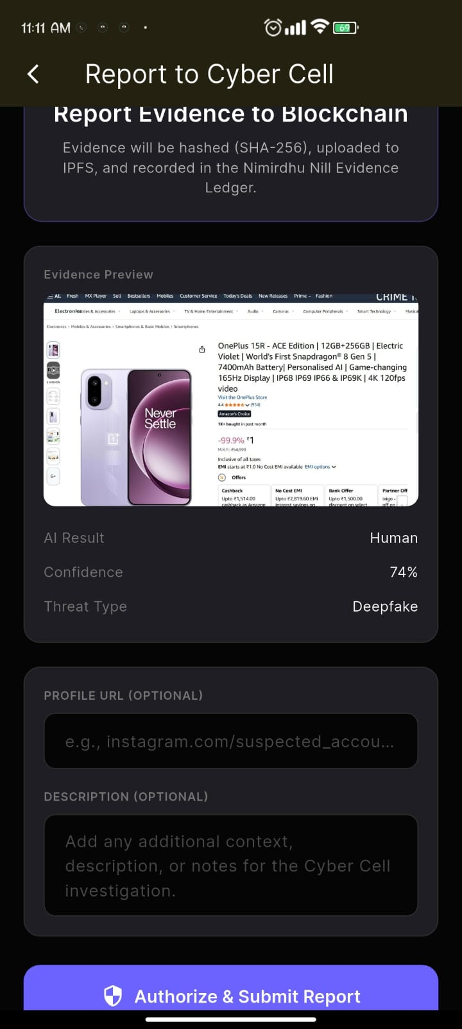
Blockchain Evidence Filing Confirmation

Slide 28
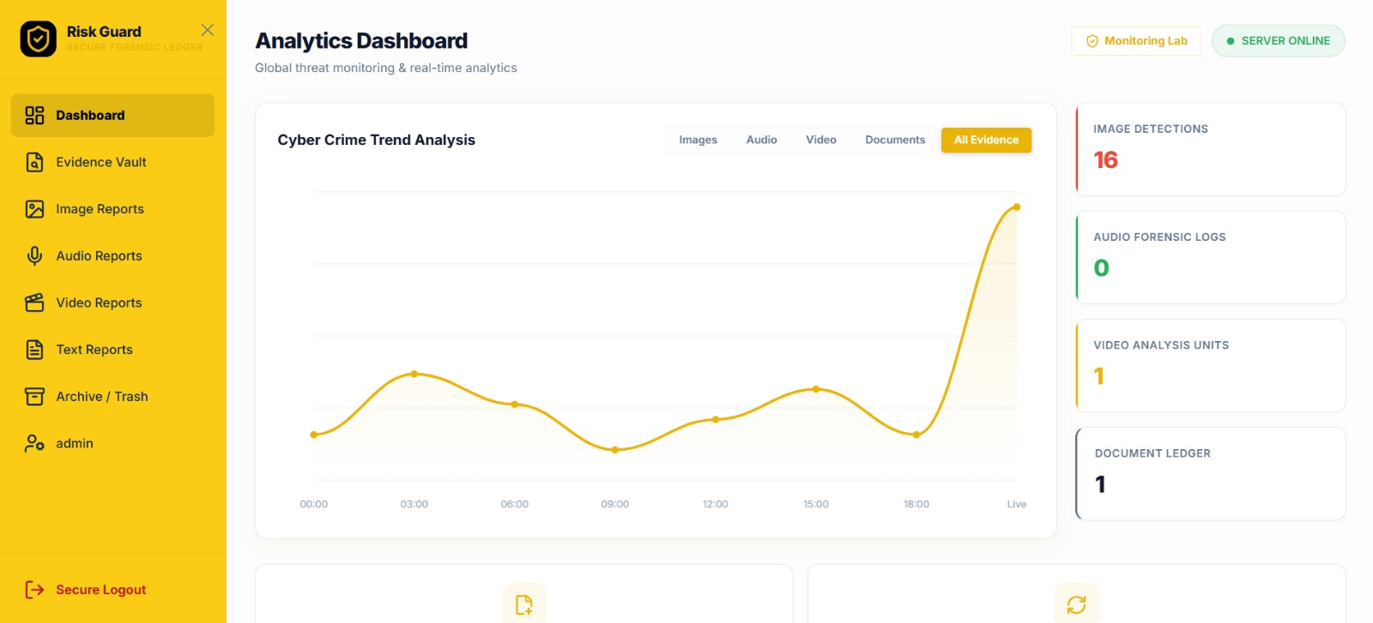
Cybercrime Investigation Web Dashboard

Slide 29
Future Enhancements
Deploy quantized models locally via ONNX Runtime.
Adversarial robustness testing against evasion attacks.
Cross-modal fusion for multi-modal documents.
Migrate from Polygon Amoy testnet to mainnet.
Extend overlay system to iOS.
On-device NLP for SMS phishing detection.
Continuous retraining for new AI techniques.

Slide 30
Conclusion
RiskGuard integrates detection, evidence, and real-time protection.
Production-grade detection on commodity hardware.
Type-adaptive image ensemble prevents false positives.
Voice pipeline achieves real-time under 200ms.
Blockchain costs reduced 99.7% via Merkle batching.
Overlay provides continuous background monitoring.
Dual interface serves citizens and law enforcement.

Slide 31


Slide 32


Slide 33


